Slide 1


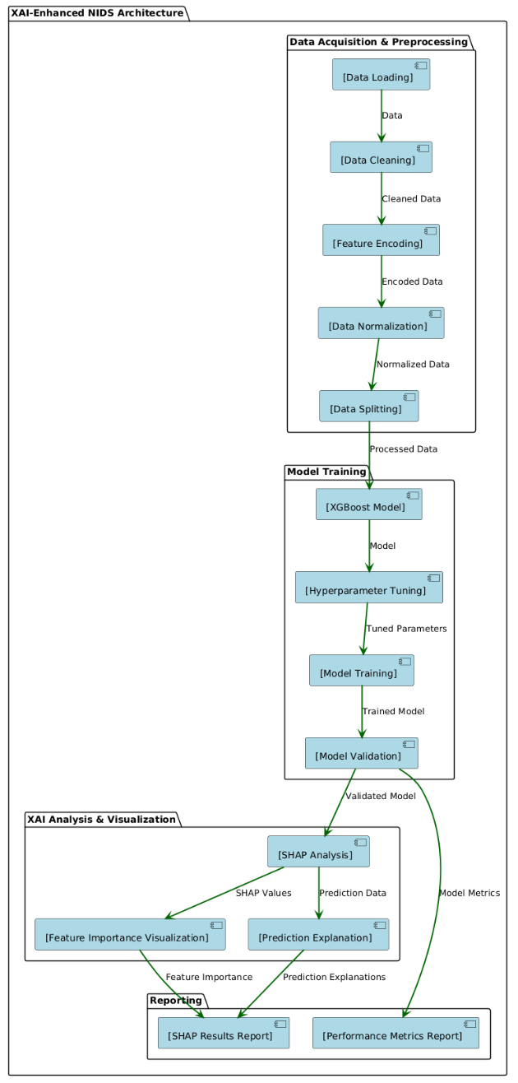
EXPLAINABLE AI FOR INTRUSION DETECTION WITH XGBOOST AND SHAP
MANJU BHASITHA G[21BRS1517], VARSHITHA CH [21BRS1545], VARUN KUMAR S[21BRS1540]
Dr. Benil T
School of Computer Science and Engineering
MOTIVATION / INTRODUCTION
The increasing sophistication of cyber threats necessitates more intelligent security solutions beyond the conventional signature-based approach.
Machine Learning models such as XGBoost are highly accurate at identifying intrusions through learning patterns in network data.
But such models tend to be "black boxes," with it being difficult for IT practitioners to understand and respond to their decisions.
Using Explainable AI (SHAP) integration, one can get behind why the model identifies an intrusion, improving transparency, trust, and practicality in the real world in cybersecurity.
OBJECTIVES
Build an effective NIDS with the XGBoost algorithm to precisely identify a range of network intrusions from the NAL-KDD dataset.
Implement SHAP (Explainable AI) for explaining the predictions of the model and knowing the rationale for every detection.
Assess system performance based on metrics such as accuracy, precision, recall, and F1-score to make it reliable.
Analyze and visualize important features affecting intrusions to create actionable insights for enhancing cybersecurity response.
SCOPE OF THE PROJECT
The scope of this project is intended to benefit cybersecurity experts with a clear and precise intrusion detection system via XGBoost and SHAP.
It targets enhancing threat detection and explainability, confined to analysis against the NAL-KDD dataset in a virtual environment.
METHODOLOGY
Preprocessing
The NAL-KDD dataset is pre-processed and used to train an XGBoost model, which is then explained using SHAP to identify key features and improve interpretability in intrusion detection.
ARCHITECTURE
We preprocess the NAL-KDD dataset and apply the XGBoost supervised learning algorithm, then integrate SHAP to interpret model predictions and analyze feature importance for improved intrusion detection.
RESULTS
CONCLUSION
The proposed XGBoost-based model achieved 95% accuracy, outperforming traditional machine learning algorithms in both precision and recall. With SHAP integration, it not only improves detection performance but also adds critical explainability for real-world cybersecurity applications.
CONTACT DETAILS
MAIL ID : bhashitagarapati11@gmail.com
MOBILE NO : 6301071780
MAIL ID : varshithachintareddy@gmail.com
MOBILE NO : 9063856815
MAIL ID : varunkumarsadineni@gmail.com
MOBILE NO : 93477 04293
REFERENCES
Ben Said, R., Sabir, Z., & Askerzade, I. (2023). CNN-BiLSTM: A Hybrid Deep Learning Approach for Network Intrusion Detection System in Software-Defined Networking with Hybrid Feature Selection. IEEE Access, 11, 138732–138747. https://doi.org/10.1109/ACCESS.2023.3340142
Park, C., Lee, J., Kim, Y., Park, J.-G., Kim, H., & Hong, D. (2023). An Enhanced AI-Based Network Intrusion Detection System Using Generative Adversarial Networks. IEEE Internet of Things Journal, 10(3), 2330–2345. https://doi.org/10.1109/JIOT.2022.3211346
Algorithm | XGBoost
Accuracy | 95%
Precision | 93%
Recall | 94%
F1-Score | 93.5%

